Slide 1

Depth-first Search (DFS)
a more aggressive strategy
always exploring from the most recently discovered vertex
going as deeply as you can
backtracking only when absolutely necessary
Just like how you might explore a maze

Slide 2
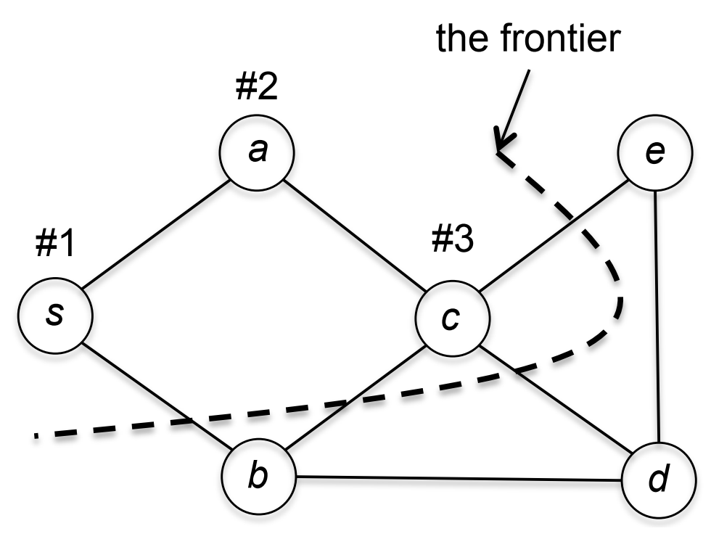
DFS example
DFS begins with starting vertex S
In 1st iteration, it examines edge (s, a)
﻿In 2nd iteration, it examines edge (a, c)
DFS always goes deeper
As soon as it finds some new vertex a,
then It will look for next vertex c from
this new vertex a.

Slide 3
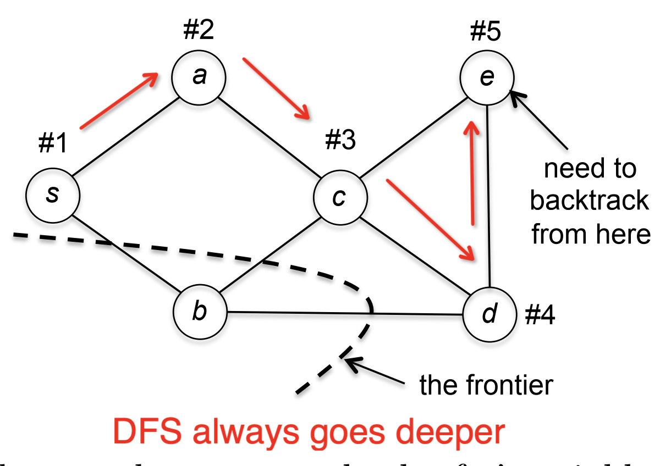
DFS example
1st iteration, edge (s, a)
﻿2nd iteration, edge (a, c)
3rd iteration, edge (c, d)
4th iteration, edge (d, e)
From e -> no new vertex is found.
So backtrack to d -> find new vertex b.
From b -> no new vertex is found.
So backtrack to d -> no new vertex is found.
So backtrack to c -> no new vertex is found.
So backtrack to a -> no new vertex is found.
So backtrack to s -> no new vertex is found.

Slide 4
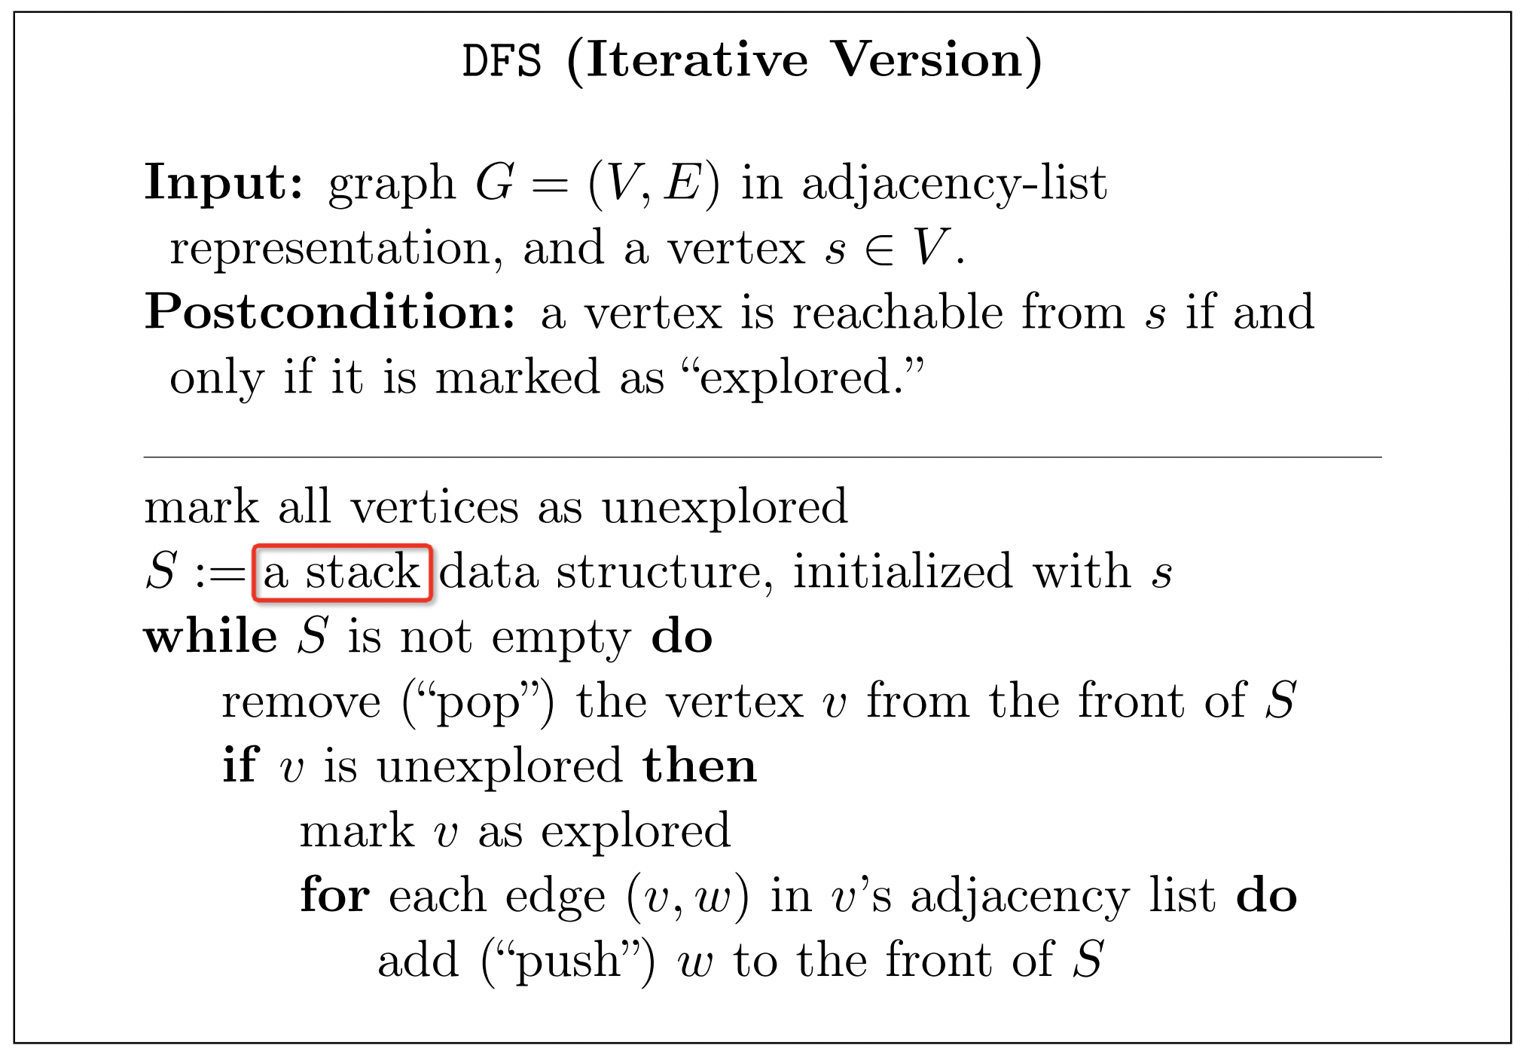
DFS uses stack
DFS uses a stack to keep track of which vertices to explore next.
Notes:
Stack -> last in, first out. That’s how we can make DFS goes deeper and deeper
Let’s see some code

Slide 5
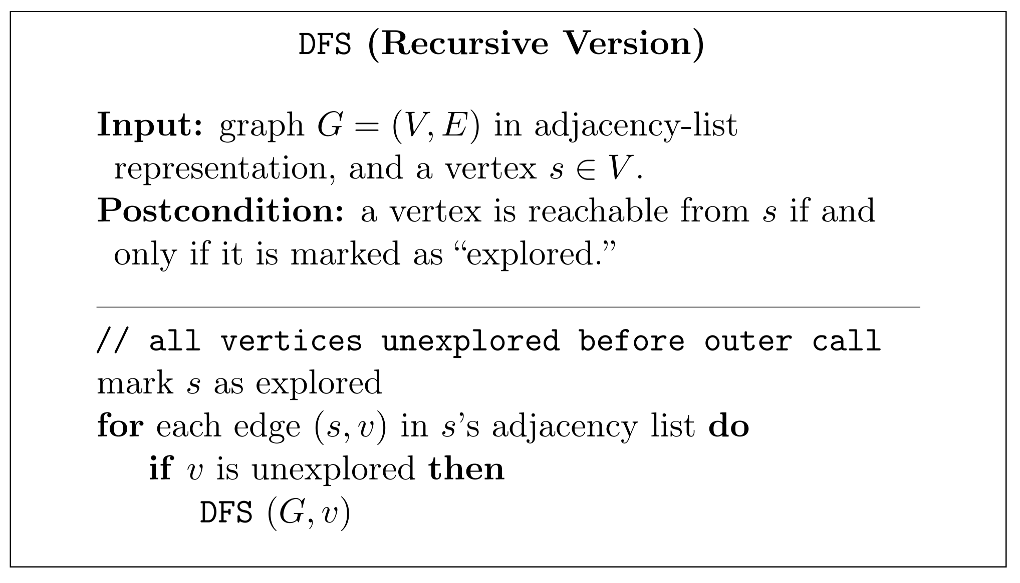
DFS has a solution 2 – Recursive (much simpler!)
Notes:
Recursive means: the function calls itself
DFS(s) means: Please find all the vertices reachable from s.
So I can just: step 1) visit s
step 2) DFS(v), as long as there is an edge (s, v)
Let’s see some code

